Slide 1


Enhancement Of Endoscopic video and Images Using Deep Learning Techniques
Presented By: M.Kedhareswer Naidu
Registration Number: 12110626
Roll Number: RK21UWA20
Course Code: CSE461
Section: K21UW
Mobile Number: +91 9398911432
Mail: Kedhareswer.12110626@gmail.com
Research Gate:
Submitted To: Aman Kumar
Dept: CSE Data Science (AI & ML)
Lovely Professional University Jalandhar Punjab India
Lovely Professional University | 2025

Slide 2








Introduction
Literature Review
01
Project Aim
Problem Statement
Objectives
02
Research Gaps
Project Timeline
Research Methodology
03
Project Timeline
04
Dataset collection
Pre-Processing
SRCNN
Dual Input U-net
Post-Processing
Implementation
Result & Discussion
05
Proposed Work Architecture
Deployment and Testing
06
Result
Limitations
Future Scope
07
Realtime
AI Integration
Generalization
08
References

Slide 3
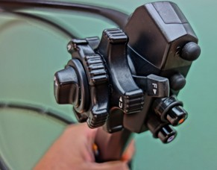
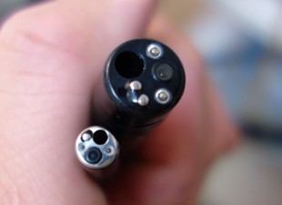
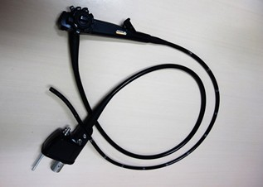
What Is Endoscopy?
An endoscopy is a procedure used in medicine to look inside the body. The endoscopy procedure uses an endoscope to examine the interior of a hollow organ or cavity of the body. Unlike many other medical imaging techniques, endoscopes are inserted directly into the organ.
There are many types of endoscopies. Depending on the site in the body and type of procedure, an endoscopy may be performed by either a doctor or a surgeon. A patient may be fully conscious or anaesthetized during the procedure. Most often, the term endoscopy is used to refer to an examination of the upper part of the gastrointestinal tract, known as an esophagogastroduodenoscopy.
Operator handle - PENTAX Colonoscope
?
Introduction
Insertion Tip of Endoscope
Flexible Endoscope
Lovely Professional University | 2025

Slide 4

Problem 1
Low Resolution: Due to the miniaturization of endoscopic devices, captured images often lack fine detail.
Project Aim
Problem 2
To develop a deep learning-based enhancement framework that significantly improves the quality of endoscopic images and videos by addressing common issues such as low resolution, noise, and poor contrast. The system combines Super-Resolution Convolutional Neural Networks (SRCNN), a Dual-Input U-Net, and advanced post-processing techniques to produce clearer, sharper, and diagnostically useful visuals, thereby assisting clinicians in making more accurate and confident medical decisions.
Motion Blur & Glare: In vivo environments introduce motion artifacts and lighting inconsistencies.
Problem 3
Noise from Motion or Poor Lighting
Lovely Professional University | 2025

Slide 5
Objectives
PLAN
PLAN
PLAN
PLAN
1
2
3
4
Enhance Endoscopic Image Quality
Preserve Anatomical Structures
Use Deep Learning Techniques
Develop a Web Application
Improve clarity, resolution, and contrast.
Maintain medical detail during enhancement.
Combine SRCNN and Dual-Input U-Net.
Test the trained model in real-time.
Lovely Professional University | 2025

Slide 6
Literature Review

Slide 7
S.NO | STUDY | METHODOLOGY | FINDINGS
01 | Aakerberg et al. (2021) | RELLISUR dataset for low-light image super-resolution using deep learning. | Provided realistic low-light data for better model generalization.
02 | An et al. (2022) | EIEN: Enhancement network based on Retinex theory. | Improved illumination in endoscopic images.
03 | Chen et al. (2023) | Two-stage deep framework for OCT angiography enhancement. | Enhanced image clarity and diagnostic value.
04 | Chen et al. (2022) | Review of deep learning in medical imaging. | Highlighted progress in segmentation, classification, and enhancement.
05 | Csurka (2024) | Survey on domain adaptation techniques. | Identified methods for visual model generalization.
06 | Dietterich (2000) | Introduction of ensemble learning methods. | Demonstrated improvement in model robustness.

Slide 8
S.NO | STUDY | METHODOLOGY | FINDINGS
07 | Espinosa et al. (2022) | Exposure correction using multi-scale structure-aware methods. | Enhanced low-light and overexposed endoscopic visuals.
08 | Garcia-Vega et al. (2022) | Exposure correction with multi-scale processing. | Reduced glare and improved brightness balance.
09 | Han et al. (2024) | AI-based smoke removal and image enhancement in surgery. | Increased visibility during surgical procedures.
10 | He et al. (2015) | Deep Residual Networks (ResNet). | Enabled deeper networks without vanishing gradients.
11 | Hoang et al. (2024) | AI capsule endoscopy system for healthcare. | Demonstrated potential in automated image interpretation.
12 | Huang et al. (2017) | DenseNet for efficient deep feature propagation. | Improved gradient flow and model performance.
13 | Kong et al. (2024) | Integration of super-resolution with deep learning. | Enhanced periodontal image segmentation.

Slide 9
S.NO | STUDY | METHODOLOGY | FINDINGS
14 | Koohestani et al. (2024) | BrightVAE: Underexposed endoscopic image enhancement using VAE. | Boosted luminosity while preserving structure.
15 | LeCun et al. (2015) | Deep learning fundamentals and applications. | Established deep learning as core AI methodology.
16 | Mou et al. (2023) | Global-local enhancement for low-light endoscopy. | Balanced enhancement across different image regions.
17 | Nie et al. (2024) | Comprehensive review of deep learning in endoscopy. | Identified gaps and future directions in clinical AI tools.
18 | Regmi et al. (2023) | Vision Transformer for chest and GI image classification. | Improved accuracy over traditional CNNs.
19 | Sagar et al. (2024) | Hybrid ResNet and DenseNet for abnormality detection. | Achieved high multi-class classification performance.
20 | Srivastava et al. (2022) | CNN with focal modulation for capsule video classification. | Improved classification of GI abnormalities.

Slide 10
S.NO | STUDY | METHODOLOGY | FINDINGS
21 | Wang et al. (2024) | Lightweight CNN for color correction in capsule endoscopy. | Optimized detail with low computational load.
22 | Wang & Meng (2023) | Depth estimation using deep learning for endoscopic images. | Improved spatial awareness for navigation.
23 | Wu & Gu (2023) | Pose and depth estimation with compatible endoscopic images. | Enabled better real-time mapping.
24 | Xu et al. (2023) | Review on deep learning-based image inpainting. | Outlined applications in medical image restoration.
25 | Zhang et al. (2024) | Transfer learning for endoscopy quality control. | Enabled domain adaptation for image filtering.
26 | Zhao et al. (2023) | Endoscopic classification using deep transfer learning. | Enhanced classification across imaging domains.
27 | Sneha & Sreenithy (2025) | Matrix-based joint demosaicing and super-resolution. | Improved resolution in clinical imaging.

Slide 11
Gaps In The Literature
STUDIES | GAPS
Aakerberg et al. (2021) | Dataset focused only on low-light super-resolution, lacking structural enhancement methods.
An et al. (2022) | Enhancement limited to illumination correction; structural preservation not addressed.
Chen et al. (2023) | Targeted OCT imaging, not directly applicable to endoscopic imaging challenges.
Chen et al. (2022) | Focused on broad DL applications; lacked specific strategies for endoscopic enhancement.
Csurka (2024) | Explored domain adaptation but did not propose direct enhancement techniques.

Slide 12
STUDIES | GAPS
Dietterich (2000) | Introduced ensemble learning but did not target image quality or medical imaging.
Espinosa et al. (2022) | Lacked focus on noise reduction and anatomical detail preservation.
Garcia-Vega et al. (2022) | Addressed exposure issues but ignored structural texture refinement.
Han et al. (2024) | Focused on smoke removal in surgery, not resolution or texture enhancement.
He et al. (2015) | Provided ResNet model but not optimized for medical enhancement tasks.
Hoang et al. (2024) | Focused on AI system design, not specific to enhancing image resolution or contrast.
Huang et al. (2017) | Proposed DenseNet but didnâ€™t address post-processing for image clarity.

Slide 13
STUDIES | GAPS
Kong et al. (2024) | Limited to dental radiographs; not tested on endoscopic data.
Koohestani et al. (2024) | Focused only on luminosity; lacked enhancement of texture or detail.
LeCun et al. (2015) | General overview of DL; did not address specific medical image enhancement needs.
Mou et al. (2023) | Did not validate on diverse endoscopic datasets; lacked texture restoration.
Nie et al. (2024) | Review paper; did not propose or test enhancement framework.
Regmi et al. (2023) | Targeted classification tasks, not resolution or detail enhancement.
Sagar et al. (2024) | Focused on abnormality detection, not image quality improvement.

Slide 14
STUDIES | GAPS
Srivastava et al. (2022) | Worked on classification in video endoscopy; enhancement not addressed.
Wang et al. (2024) | Lightweight model lacked depth for high-resolution texture enhancement.
Wang & Meng (2023) | Focused on depth estimation; not designed for visual quality improvement.
Wu & Gu (2023) | Did not enhance image clarity; focused on pose/depth estimation.
Xu et al. (2023) | Discussed image inpainting; did not propose real-time endoscopic enhancement.
Zhang et al. (2024) | Addressed quality control but not enhancement of poor-quality images.
Zhao et al. (2023) | Focused on classification using TL; lacked enhancement components.

Slide 15
Research Exploring
JAN
15%
Literature review, problem identification, finalizing datasets and tools
Model Designing and Brainstorming
FEB
25%
Model design (SRCNN + Dual-Input U-Net), coding architecture, preprocessing
Model Training and Tuning
MAR
30%
Model training, integration of post-processing techniques
Lovely Professional University | 2025
Testing and Hyperparameters Tuning
APR
15%
Testing, evaluation using PSNR & SSIM, tuning, visual result analysis
Report Writing and Submission
MAY
10%
Report writing, PPT preparation, project documentation, viva & submission

Slide 16
01
Dataset
Methodology
And Preprocessing
SRCNN
02
03
U-Net
Super Resolution CNN
Structural Refinement
L1 Loss
04
05
Post
Loss Function Design
Post-Processing
Result
06
And Evaluation
Lovely Professional University | 2025

Slide 17

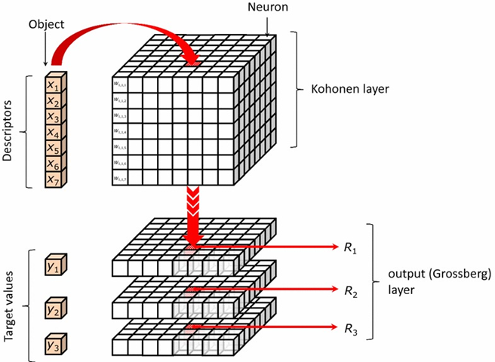
01
Dataset
And Preprocessing
Images Resized:
299 * 299
Normalization
Dataset Name | Size | Description
Kvasir-SEG | 44.1 MB | Pixel-level segmentation masks and RGB images of polyps
Kvasir – Gastrointestinal Disease Detection | 2.3 GB | Multi-class GI disease image dataset
GastroEndoNet | 407 MB | Annotated images for endoscopic abnormality detection
Endoscopic Real-Synthetic Over & Underexposed Frames | 192 MB | Challenging lighting scenarios for image enhancement
EAD – Endoscopy Artifact Detection | 200 MB | Images with labeled artifacts (e.g., motion blur, specular reflections)
RGB Conversion
Lovely Professional University | 2025

Slide 18
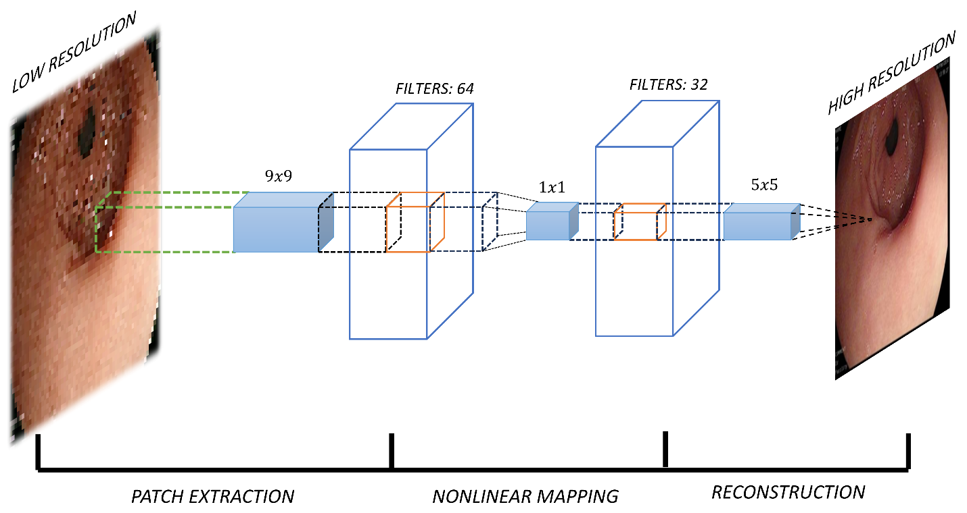
Why SRCNN?
SRCNN is lightweight, fast to train, and integrates well with subsequent models. In this project, its output serves as one of the inputs for a Dual-Input U-Net, providing the model with an enriched, high-detail version of the original image.
How it is Used?
SRCNN is used as the first deep learning stage to enhance the resolution of low-quality endoscopic images. It processes the preprocessed input through a 3-layer CNN (feature extraction, non-linear mapping, reconstruction) to restore fine details lost due to small sensors and poor lighting. The sharper SRCNN output is then combined with the original image and passed to a Dual-Input U-Net, enabling better structural refinement.
SRCNN
02
Super Resolution CNN
Lovely Professional University | 2025

Slide 19
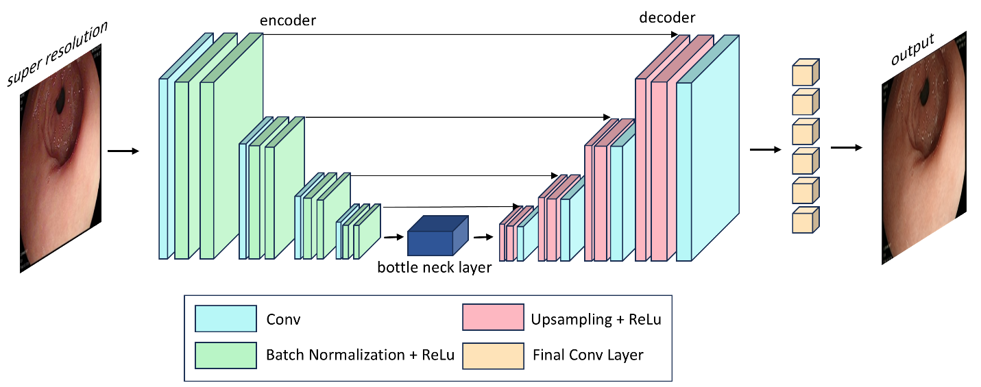
Why U-Net?
03
U-Net
Structural Refinement
U-Net was chosen for its ability to enhance structural details in medical images through its encoder-decoder architecture with skip connections, which preserves spatial features while learning deep representations. In our project, a Dual-Input U-Net takes both the original and SRCNN-enhanced images to combine raw spatial context with high-frequency details, resulting in sharper, clearer outputs.
How it is Used?
Dual-Input U-Net takes both the original and SRCNN-enhanced endoscopic images as inputs to refine anatomical structures and textures. The encoder part extracts deep hierarchical features from both inputs, while the decoder reconstructs the enhanced image using upsampling and skip connections to preserve spatial detail.
Lovely Professional University | 2025

Slide 20
05
Post
Technique | Purpose | Effect
CLAHE (Contrast Limited Adaptive Histogram Equalization) | Enhances local contrast in low-light regions | Prevents over-amplification of noise
Gamma Correction | Adjusts brightness using a nonlinear curve | Reveals hidden details in dark areas
Non-Local Means Denoising | Removes background noise while preserving textures | Maintains essential structures
Image Sharpening | Highlights edges and fine details | Restores lost details from previous stage
White Balancing | Corrects unnatural color tones | Improves visual accuracy
Post-Processing
In our enhancement framework (SRCNN + Dual-Input U-Net), L1 loss helps preserve fine details in the enhanced image without being too sensitive to outliers (unlike MSE).
It contributes to:
Pixel-level accuracy in reconstructed endoscopic images
Maintaining anatomical integrity in enhanced visuals
Balancing smoothness and sharpness when combined with MSE and Edge Loss
L1 Loss
04
Loss Function Design
Lovely Professional University | 2025

Slide 21
Lovely Professional University | 2025

Slide 22
Input
Pre-Processing
Proposed Framework
SRCNN
U-Net
Post Processing
Results
Lovely Professional University | 2025

Slide 23
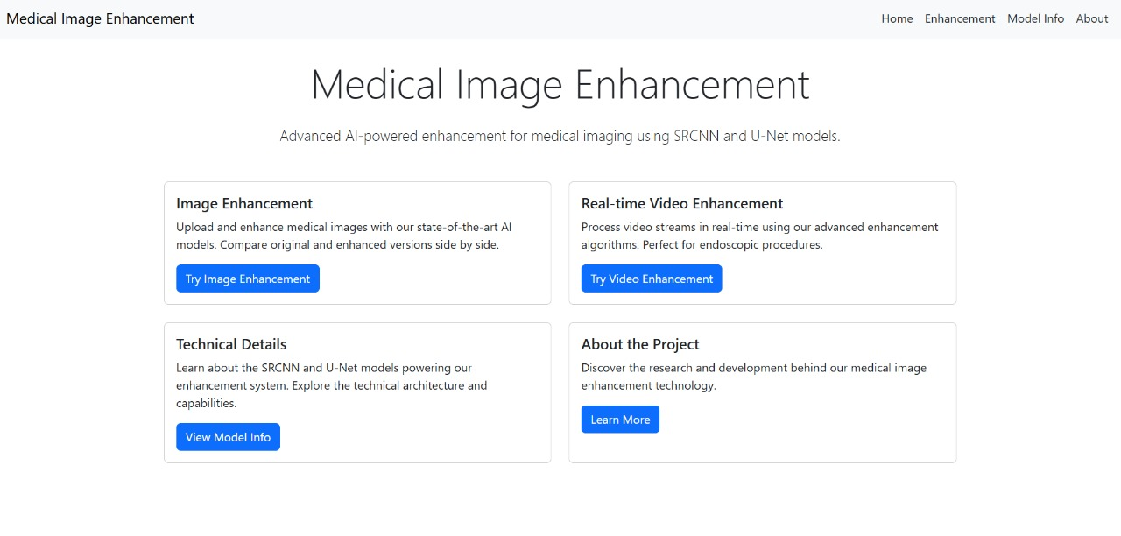
Lovely Professional University | 2025

Slide 24
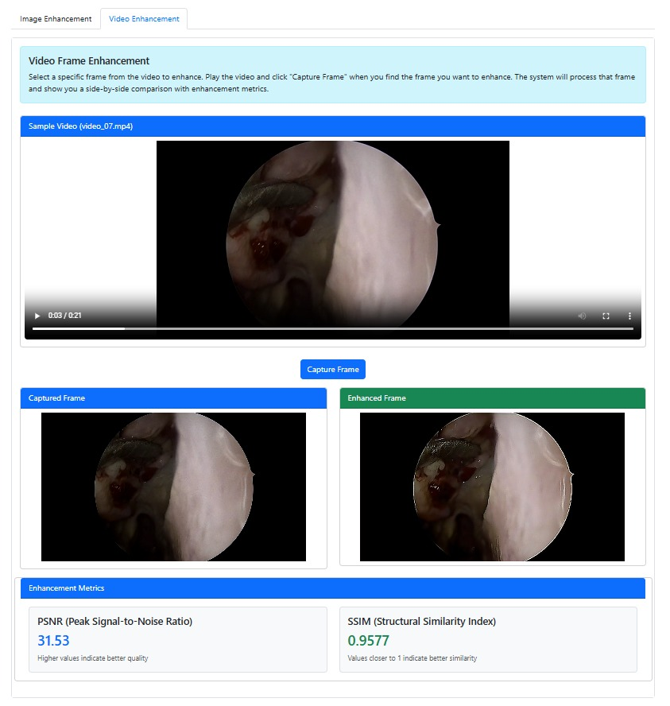
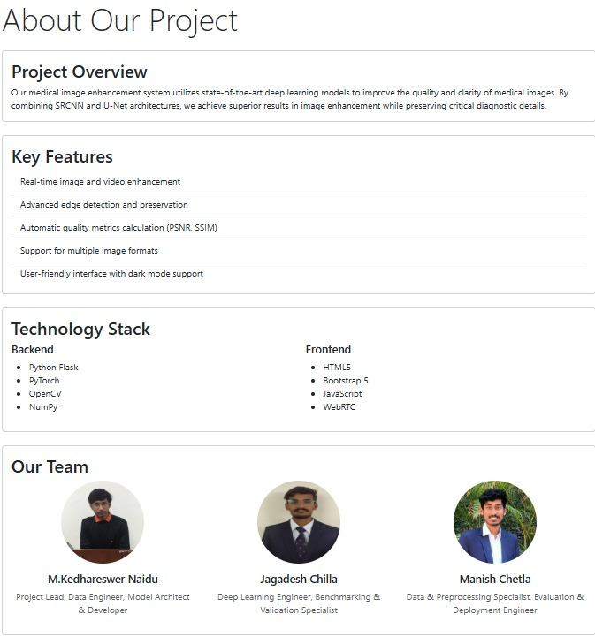

Slide 25
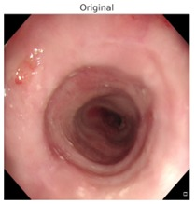
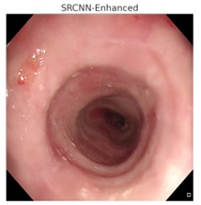
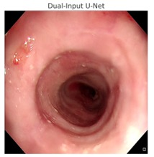
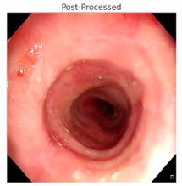
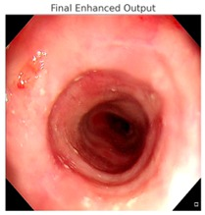
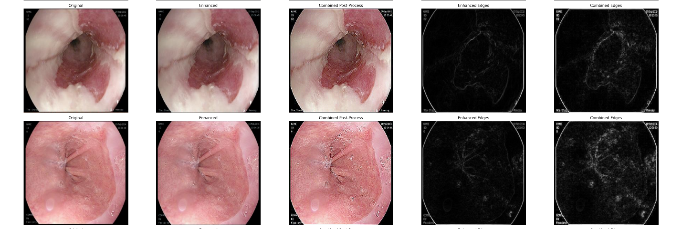

Slide 26





PSNR and SSIM are generic image quality metrics and do not measure clinical relevance directly.
An ideal system would include diagnostic validation, such as accuracy of disease detection before and after enhancement.
Metrices Lack Clinical Relevance
Enhancing edges via sharpening or SRCNN can sometimes amplify noise or artifacts, especially in already noisy regions.
There is a delicate balance between improving fine details and introducing false positives that could confuse medical interpretation.
Edge preservation trade-offs
The model has not yet been tested or validated in a real clinical setup.
It has not been reviewed or approved for diagnostic use by any regulatory body (e.g., FDA, CE).
Non-Clinical Trails or FDA Validations
The model is trained on five specific public datasets, which may not fully represent all medical environments.
Without retraining, the model may not generalize well to images from different hospitals, devices, or regions.
Dataset Dependency
The combined architecture of SRCNN + Dual-Input U-Net is computationally intensive.
Real-time processing is not currently possible without high-end GPUs.
Training and inference are slow on limited-resource systems like CPUs or basic laptops.
High Computational Requirements
Lovely Professional University | 2025

Slide 27






Improved Generalization Across Devices
Real-Time Clinical Deployment
AI-Assisted Diagnosis Integration
Generative AI for Enhanced Detail
Lovely Professional University | 2025
Multi-Modal Learning for Holistic Care

Slide 28
1. Nie, Z., Xu, M., Wang, Z., Lu, X., Song, W. (2024). A Review of Application of Deep Learning in Endoscopic Image Processing. J. Imaging, 10(11), 275. https://doi.org/10.3390/jimaging10110275
2. Wang, X., Meng, X. (2023). Research on Endoscopic Image Depth Estimation Method Based on Deep Learning. In: Proc. Int. Conf. Artif. Intell. Blockchain Technol. (AIBT), pp. 33–36.
3. Espinosa, R., Garcia-Vega, A., Ochoa-Ruiz, G. (2022). Multi-Scale Structural-Aware Exposure Correction for Endoscopic Imaging. arXiv:2210.15033. https://doi.org/10.48550/arXiv.2210.15033
4. Garcia-Vega, A., Espinosa, R., Ramirez-Guzman, L., Bazin, T., Falcon-Morales, L., Ochoa-Ruiz, G., Lamarque, D., Daul, C. (2022). Multi-Scale Structural-aware Exposure Correction for Endoscopic Imaging. arXiv:2210.15033. https://doi.org/10.48550/arXiv.2210.15033
5. Koohestani, F., Nabizadeh, Z., Karimi, N., Shirani, S., Samavi, S. (2024). BrightVAE: Luminosity Enhancement in Underexposed Endoscopic Images. arXiv:2411.14663. https://doi.org/10.48550/arXiv.2411.14663
6. LeCun, Y., Bengio, Y., Hinton, G. (2015). Deep Learning. Nature, 521, 436–444. https://doi.org/10.1038/nature14539
7. Chen, Q., Wu, M., Yang, G., Xu, M., Ma, Y., Cao, J., Xu, Z., Zhao, Y. (2023). A Two-Stage Framework for Optical Coherence Tomography Angiography Image Quality Improvement. Front. Med. https://doi.org/10.3389/fmed.2023.1061357
8. Chen, X., Wang, X., Zhang, K., Fung, K.M., Thai, T.C., Moore, K., Mannel, R.S., Liu, H., Zheng, B., Qiu, Y. (2022). Recent Advances and Clinical Applications of Deep Learning in Medical Image Analysis. Med. Image Anal., 79, 102444. https://doi.org/10.1016/j.media.2022.102444
9. He, K., Zhang, X., Ren, S., Sun, J. (2015). Deep Residual Learning for Image Recognition. arXiv:1512.03385
10. Han, J., Eoh, K.J., An, M.C., Lee, S.H., Yang, S. (2024). Enhancing Endoscopic Surgical Imaging: AI-Based Smoke Removal and Image Enhancement. In: Proc. IEEE Int. Conf. Bioinformatics and Biomedicine (BIBM), pp. 7055–7057.
11. Huang, G., Liu, Z., van der Maaten, L., Weinberger, K.Q. (2017). Densely Connected Convolutional Networks. In: Proc. IEEE Conf. Comput. Vis. Pattern Recognit. (CVPR).
12. Kong, V., Lee, E.Y., Kim, K.A., Shon, H.S. (2024). Integrating Super-Resolution with Deep Learning for Enhanced Periodontal Bone Loss Segmentation in Panoramic Radiographs. Bioengineering, 11, 1130. https://doi.org/10.3390/bioengineering11111130
13. Hoang, M.C., Nguyen, T.L.H., Si, H.H., Le, H.A., Kim, C.S., Park, J. (2024). Toward an AI-embedded Capsule Endoscopy System for Medical Healthcare. In: Proc. IEEE Int. Conf. Commun. Electron. (ICCE), pp. 172–177.
14. Csurka, G. (2017). Domain Adaptation for Visual Applications: A Comprehensive Survey. arXiv:1702.05374
15. Dietterich, T.G. (2000). Ensemble Methods in Machine Learning. In: Lecture Notes in Computer Science, vol. 557, pp. 1–15. Springer, Berlin. https://doi.org/10.1007/3-540-45014-9_1
16. Mou, E., Wang, H., Yang, M., Cao, E., Chen, Y., Ran, C., Pang, Y. (2023). Global and Local Enhancement of Low-light Endoscopic Images. Preprints. https://doi.org/10.20944/preprints202311.1954.v1
17. Ali, S., Dmitrieva, M., Zhou, F., Daul, C., Braden, B., Bailey, A., East, J., Realdon, S., Wagnieres, G., Loshchenov, M., Blondel, W., Grisan, E., Rittscher, J. (2021). Endoscopy Artefact Detection (EAD) Dataset. Mendeley Data, V3. https://doi.org/10.17632/c7fjbxcgj9.3
18. Regmi, S., Subedi, A., Bagci, U., Jha, D. (2023). Vision Transformer for Efficient Chest X-ray and Gastrointestinal Image Classification. arXiv:2304.11529. https://doi.org/10.48550/arXiv.2304.11529
19. Sagar, A., Mehta, P., Shrivastava, M., Kumari, S. (2024). Integrating Deep Feature Extraction and Hybrid ResNet-DenseNet Model for Multi-Class Abnormality Detection in Endoscopic Images. arXiv:2410.18457. https://doi.org/10.48550/arXiv.2410.18457
20. Bitto, A.K., Bijoy, M.H.I., Shakil, K.H., Das, A., Biplob, K.B.B., Mahmud, I., Hossain, S.M.M. (2025). GastroEndoNet: Comprehensive Endoscopy Image Dataset for GERD and Polyp Detection. Mendeley Data, V3. https://doi.org/10.17632/ffyn828yf4.3
21. Wang, S., Liu, J., Zhu, R., Lian, J., Huang, C., Wei, H., Fan, Y. (2024). A Lightweight CNN for Detail Enhancement and Color Correction of Low-Light Capsule Endoscopy. In: Proc. IEEE Biomed. Circuits Syst. Conf. (BioCAS).
22. Jha, D., Smedsrud, P.H., Riegler, M.A., Halvorsen, P., de Lange, T., Johansen, D., Johansen, H.D. (2020). Kvasir-SEG: A Segmented Polyp Dataset. In: Lecture Notes in Computer Science, vol. 11962, pp. 451–462. Springer, Cham. https://doi.org/10.1007/978-3-030-37731-1_37
23. Wu, J., Gu, Y. (2023). Unleashing the Power of Depth and Pose Estimation Neural Networks by Designing Compatible Endoscopic Images. arXiv:2309.07390. https://doi.org/10.48550/arXiv.2309.07390
24. Xu, Z., Zhang, X., Chen, W., Yao, M., Liu, J., Xu, T., Wang, Z. (2023). A Review of Image Inpainting Methods Based on Deep Learning. Appl. Sci., 13(20), 11189. https://doi.org/10.3390/app132011189
25. Zhang, Y., Zhang, K., Ding, Y., Liu, S., Wang, M., Wang, X., Qin, Z., Zhang, X., Ma, T., Hu, F., Li, P., Feng, L. (2024). Deep Transfer Learning from Ordinary to Capsule Esophagogastroduodenoscopy for Image Quality Controlling. Eng. Rep., 6(3). https://doi.org/10.1002/eng2.12776
26. Zhao, S., Yi, S., Cao, C., Cheng, J., Ye, Y., Kong, M. (2023). A Framework for Endoscopic Image Classification Enhanced by Deep Transfer Learning. In: Proc. Int. Conf. Comput. Netw., Electron. Autom. (ICCNEA), pp. 10–14.
27. Sneha, C., Sreenithy, C. (2025). A Matrix-based Implicit Prior for Joint Demosaicing and Super-Resolution Algorithm. https://slidetodoc.com/a-matrixbased-implicit-prior-for-joint-demosaicing-and/

